Slide 1
WHO definition
Health is a state of complete physical, mental and social well-being and not merely the absence of disease or infirmity.

Slide 2
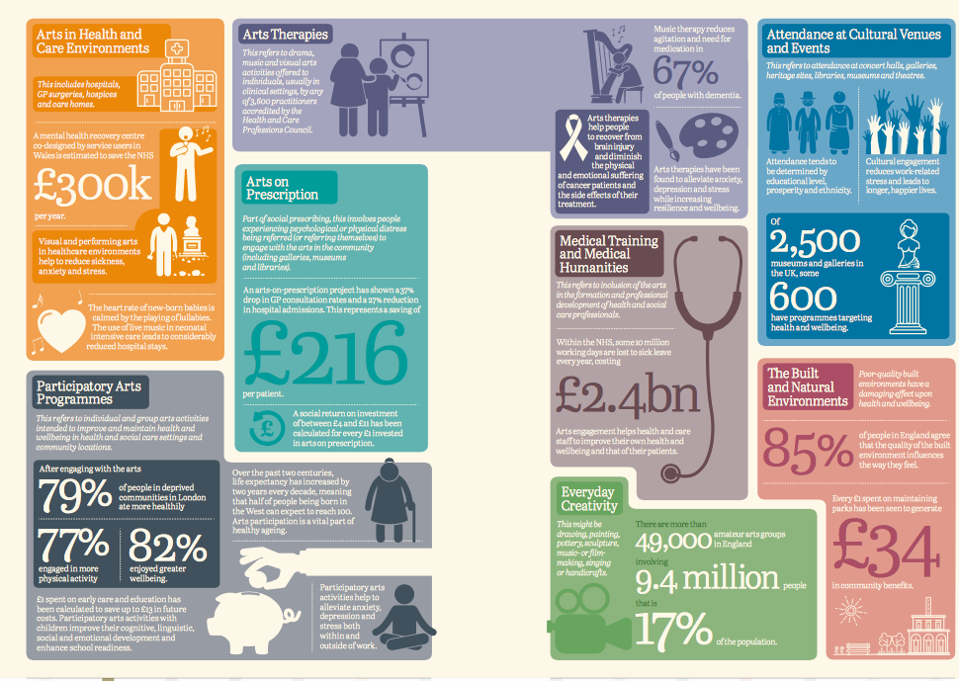
Notes:
What do we mean by arts and health

Slide 3
National context
All Party Parliamentary Group for Arts, Health & Wellbeing
Arts Council England, NHS England, Local Government Association, Public Heath England all involved and collaborating
National inquiry published Creative Health: Arts, Health & Wellbeing (2017)
National Culture, Health & Wellbeing Alliance established 2018
Notes:
Not flakey anymore- APPG and NHS England working together. At a tipping point where arts and health will become mainstream.

Slide 4
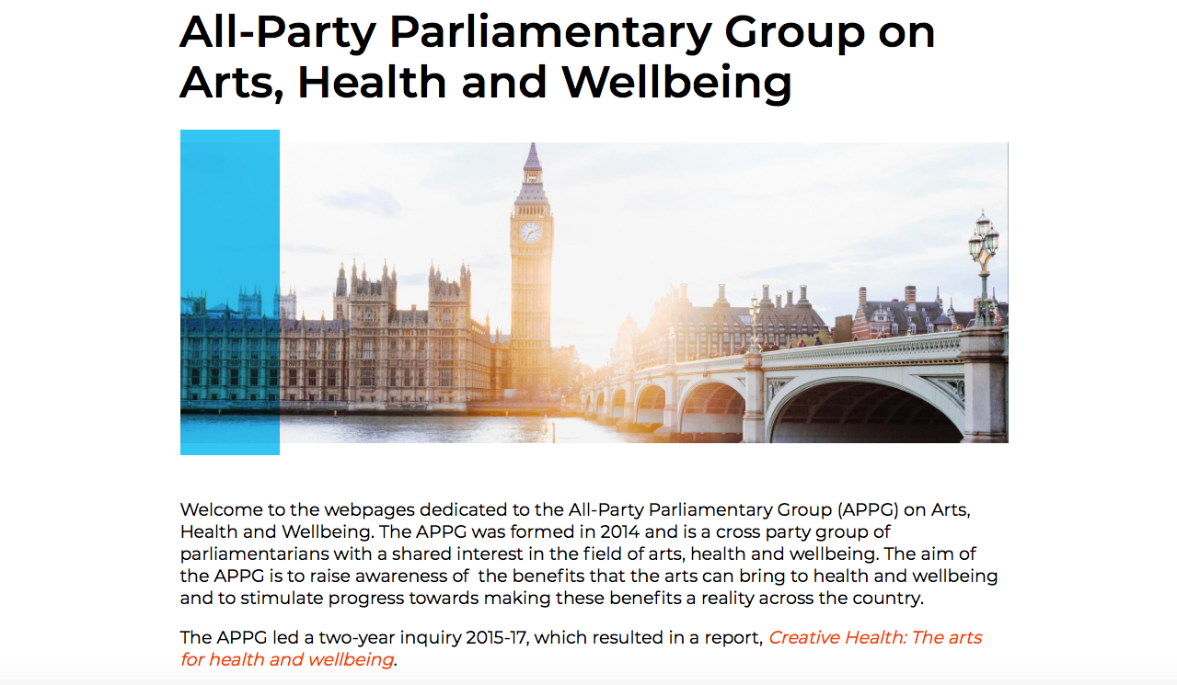

Slide 5
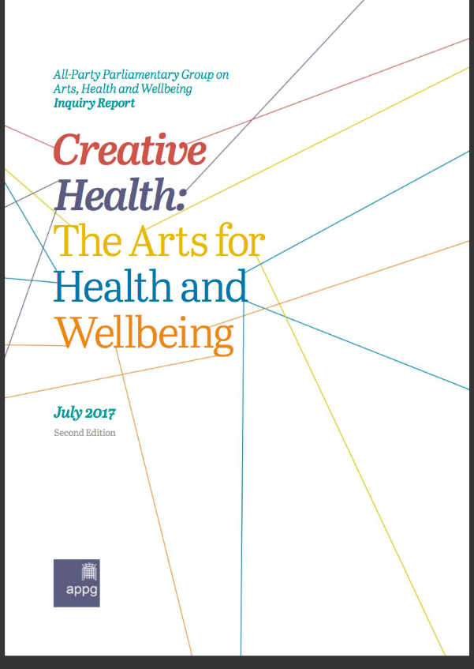

Slide 6
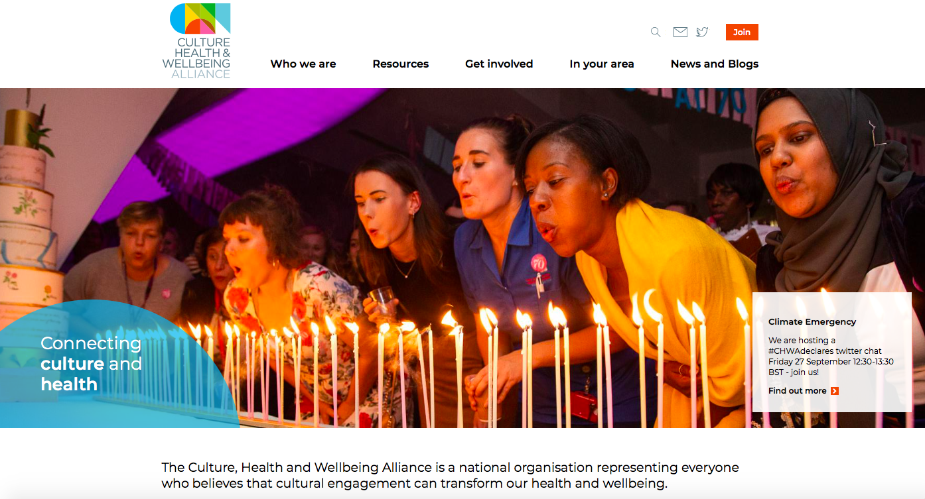

Slide 7
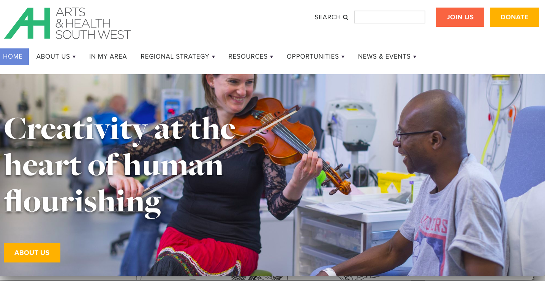
Notes:
Regional strategy emerging- Arts and Health South West.

Slide 8
Local context
.
2006 History of arts & health work in Glos
2011 Create Gloucestershire (CG) established as the county wide arts & culture umbrella
2014 – 17 Cultural Commissioning national pilot led by Create Glos & CCG
2016 Cultural Commissioning named as an enabler programme in the STP
2017 CCG mainstreamed cultural commissioning within a new social prescribing model
2017 Gloucester City awarded Great Place inc. cultural commissioning strand
2018 – 2019 Phase 2 Cultural Commissioning
.

Slide 10
Create Gloucestershire - a manifesto 2012-2020 Eight Ambitions - Eight Year 1.A cultural life that is meaningful, fully accessible and affordable to all the people who live here and which is a honey pot for successful businesses and tourists 2.A vibrant community of artists who feel nurtured and celebrated from first steps through to international career 3.Audiences that are engaged, involved and diverse so that the best artists and companies want to work here 4. Cultural venues, festivals and events across the six districts that welcome and generate fresh, inspiring and risk-taking work of an excellent standard 5.First-class communication that shouts about and celebrates Gloucestershire’s cultural life 6.Culture as a visible and cherished thread that runs through all strands of public policy – social, economic and environmental 7. Education that introduces and teaches arts and creativity at school and in other settings with the same dedication that’s given to the teaching of numeracy and literacy 8.Arts and culture “prescribed” as commonly as medicine, providing a preventative and therapeutic solution for those with health and emotional challenges.
s

Slide 11
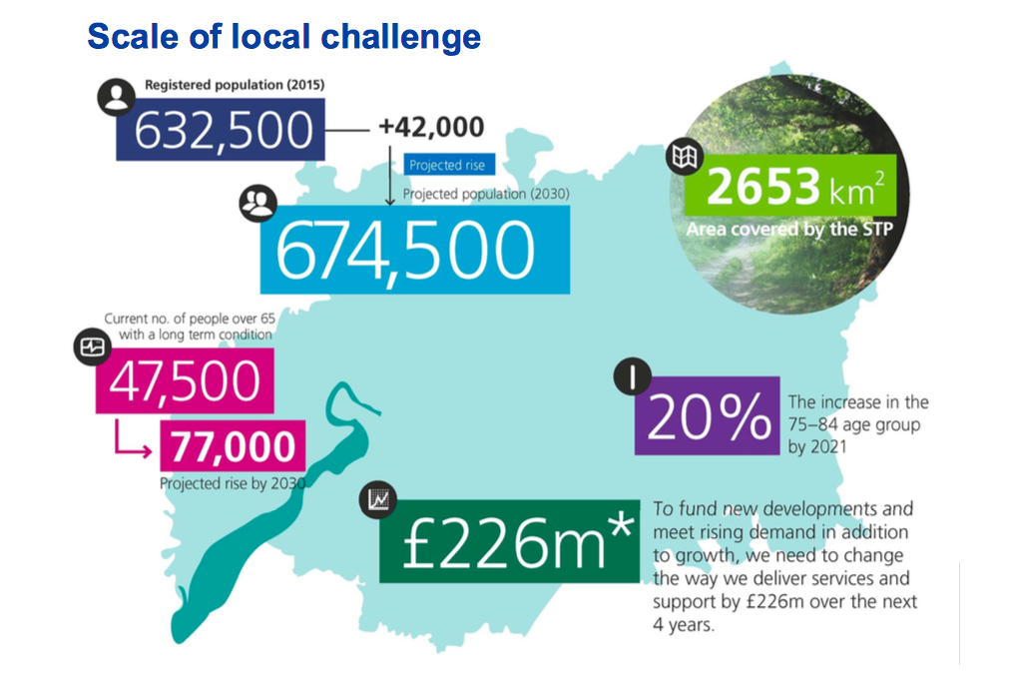

Slide 13
Opportunities 2019
.
Integrated care system- health +social care
Supportive and innovative CCG.
Move test pilots to sustained commissions
Experience/wisdom of long standing artists/orgs.
New fresh talent
Arts and Health Board county wide strategy
.

